Slide 1
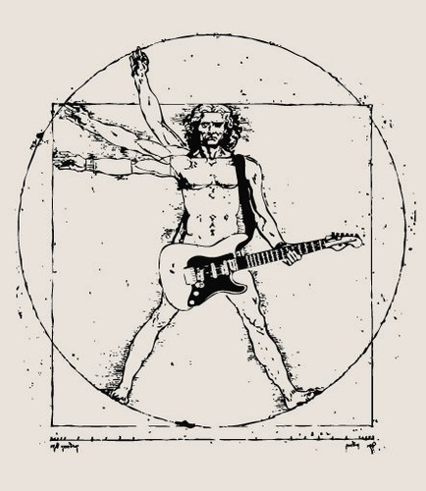
DJ’s Stream Dream
Daniel Weber
Jorge Cordova
Travis Gallegos

Slide 2
Motivation
Help Disc Jockeys’ on the job
Specific Songs Are Commonly Requested
Usually it takes at least 3 websites total to have song ready to play
With the app, DJ can get everything complete in one page

Slide 3
Description
A music app that can download songs based on search specified criteria
The app contains download history for business analytics & future reference
Overcome music player 3rd party restrictions

Slide 4
API Characteristics
API User Requirements
API App Requirements
Free API No regular UI authorization Req’d UI friendly
Band Title Song Title Album YouTube Video ID

Slide 5
Team Efforts/Delegating Work
As a team, we brainstormed desired features
Everyone discussed potential methods to achieve goals
During the discussion, each team member decided on their own what part of the app they wanted to work on
We gave dates we each thought we could accomplish our task by and communicated progress

Slide 6
Individual Responsibilities/Challenges
We divided the project into 3 parts
Pull Info from API - Daniel Display and Download Songs - Jorge Firebase – Travis & Jorge Front end - Everyone contributed

Slide 7
Challenges
Videos To Load
API Changed
Getting download button to save info to firebase (prevent default).
Data Returning From Firebase In Table
Potential solutions:
CSS/Array/Sort.Reverse/Data Manipulation

Slide 8
Results
The app has all of the key functions our team set out to create.
The team will be able to use this in the future

Slide 9
Improvements
Login Page With User Name & Password
Obfuscated JS Code On Log In Page

Slide 10
Questions?

